Slide 1

Spin Hall Effect
Kisoo Nam
The Elmore Family School of Electrical and Computer Engineering,
Purdue University, West Lafayette, Indiana

Slide 2
Content
Basic information about Spin Hall Effect
2. Spin Hall Effect vs. Inverse Spin Hall Effect
3. Spin Hall Effect in MRAM

Slide 3
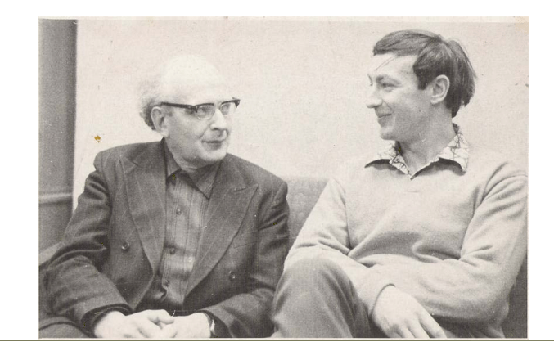
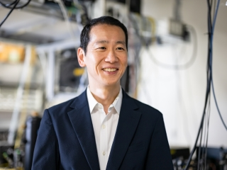
History of SHE
Frist predicted by Mikhail Dyakonov and Vladmir Perel in 1971.
At 2004, Spin Hall Effect was observed in semiconductors (GaAs and InGaAs) experimentally by Yuichiro Kato.
Mikhail Dyakonov and Vladmir Perel
Yuichiro Kato

Slide 4
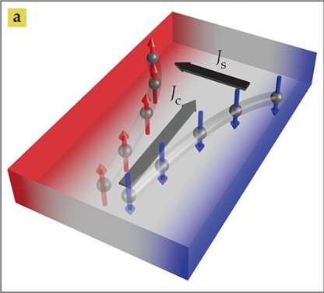
What is SHE
SHE is a transport phenomenon in which a charge current generates a spin current.
As a result, spins accumulate at opposite edges of a material.
Jairo Sinova et al. Physics Today, July 2017

Slide 5
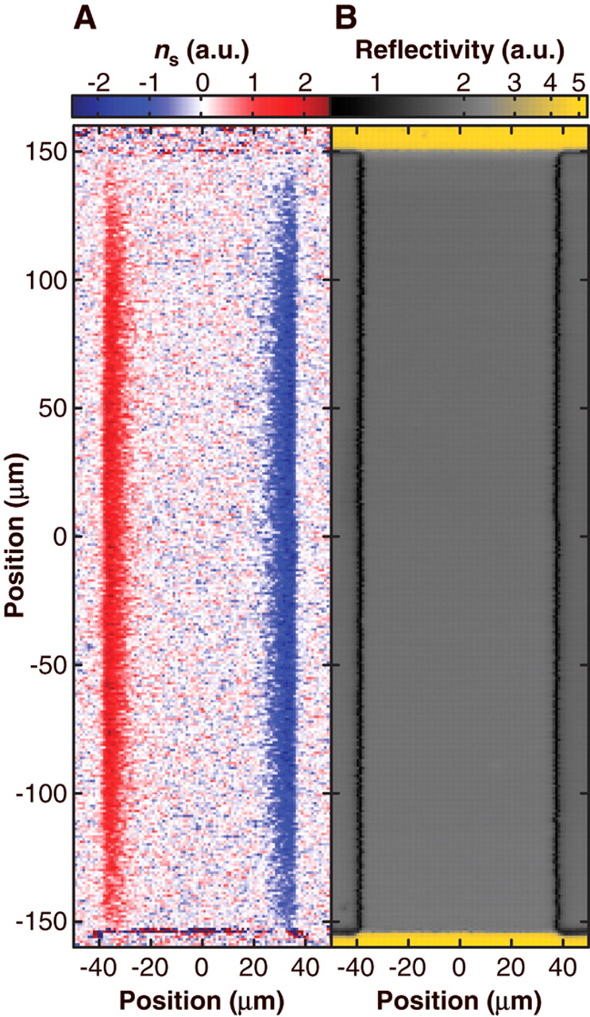
What is SHE
SHE is a transport phenomenon in which a charge current generates a spin current.
As a result, spins accumulate at opposite edges of a material.
In 2004, Kato experimentally demonstrated that opposite spin polarizations accumulate on opposite sides of material.
Yuichiro Kato et al. Science, Vol. 306, No. 5703, 2004

Slide 6
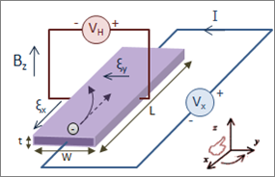
Difference between HE and SHE
Hall Effect
Spin Hall Effect
[1]
Jairo Sinova et al. Physics Today, July 2017
Hall effect requires an “external” magnetic field to deflect charges.
In spin hall effect, moving electrons experience an “effective” magnetic field and this magnetic field generate spin current.

Slide 7
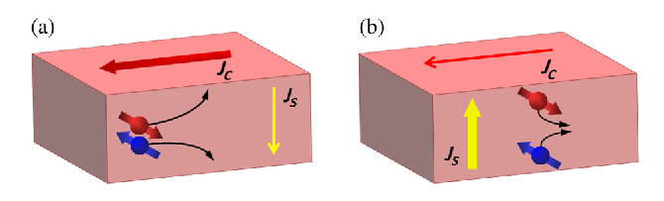
Inverse Spin Hall Effect (ISHE)
ISHE is the opposite transport phenomenon compared to SHE.
When the spin current (J_{s}) injected to the materials the charge current (J_{c}) will flow.
B. Miao et al. Physical Review Letters, August 2013

Slide 8
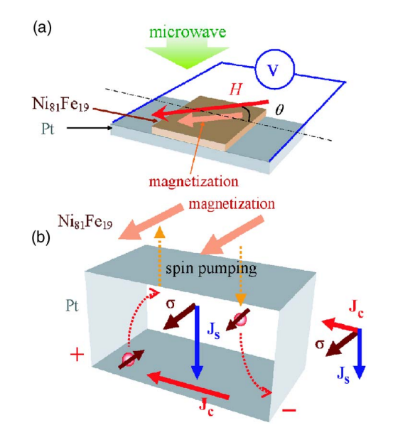
Inverse Spin Hall Effect (ISHE)
E. Saitoh et al. Applied Physics Letters, 88, 182509, 2006
By using ferromagnetic Ni₈₁Fe₁₉ and spin pumping technique, spin current can be injected to the materials.
Two terminal connected to Pt will detect the charge current (J_{c}).

Slide 9
Content
Basic information about Spin Hall Effect
2. Spin Hall Effect vs. Inverse Spin Hall Effect
3. Spin Hall Effect in MRAM

Slide 10
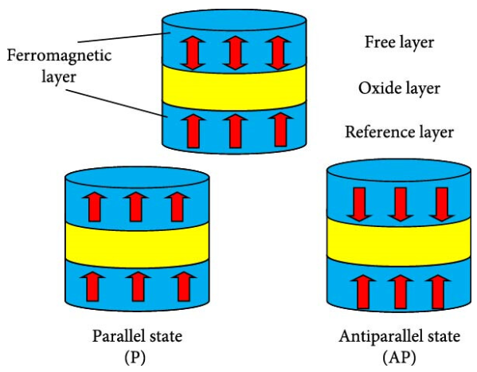
What is MTJ
Jianyu Wu et al. IET Circuits, Devices & Systems, 2024
Magnetic tunnel junction (MTJ) comprises a two ferromagnetic layer and one oxide layer.
Parallel state shows high tunneling probability and low resistance (0), while antiparallel states shows high resistance (1).

Slide 11
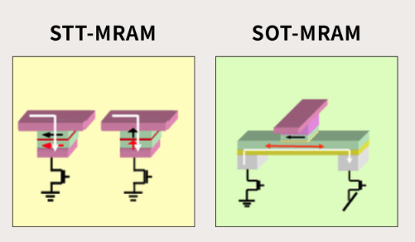
STT-MRAM vs. SOT-MRAM
[2]
In STT-MRAM charge current flow directly to MTJ. This stresses the oxide barrier which makes device reliability poor.

Slide 12
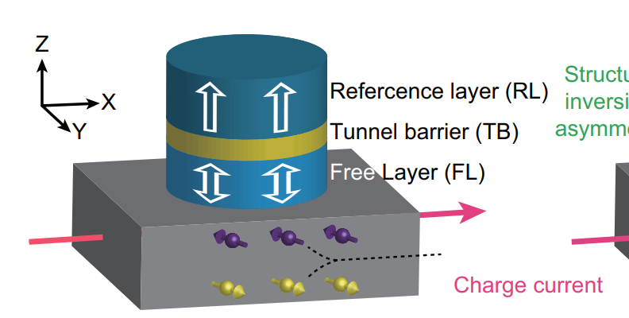
STT-MRAM vs. SOT-MRAM
Chao Wang et al. IEEE 15th ICSICT, 2020
However, in SOT-MRAM the charge current flow the metal line under the MTJ.
By using SHE, spin current is generated and this spin current switch the free layer.

Slide 13
Summary
SHE causes electrons with opposite spins to accumulate on opposite sides of a materials.
Unlike HE, SHE does not require an external magnetic field.
SHE plays a critical role in modern spintronic applications, especially in SOT-MRAM, where it enhances device performance and endurance.
Jairo Sinova et al. Physics Today, July 2017

Slide 14
Reference
[1] electromagnetism - The workings of the Hall effect? - Physics Stack Exchange
[2] [Future Semiconductor Technology] The Present of the Next-Generation Ultra-Low-Power MRAM Technology - SK hynix Newsroom

